Slide 1
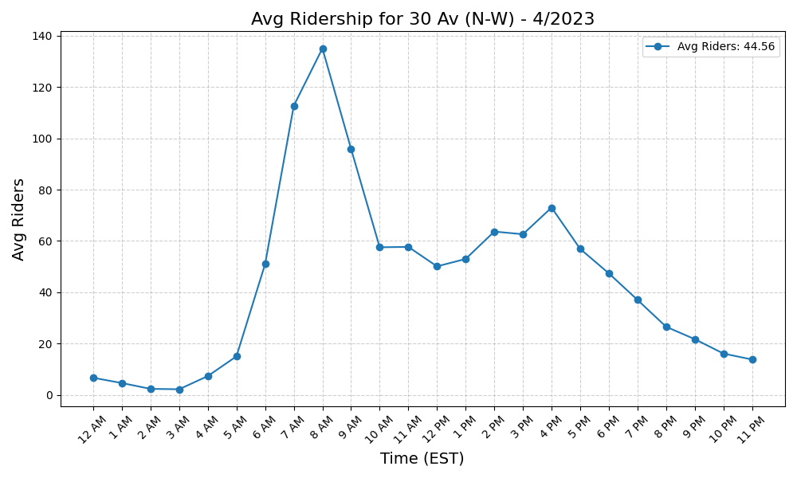
30 Av (N-W) - 4/2023

Slide 2
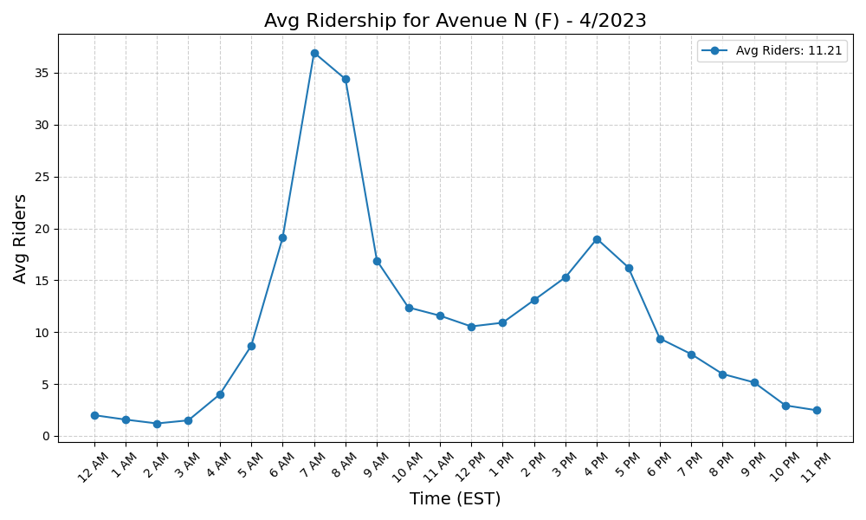
Avenue N (F) - 4/2023

Slide 3
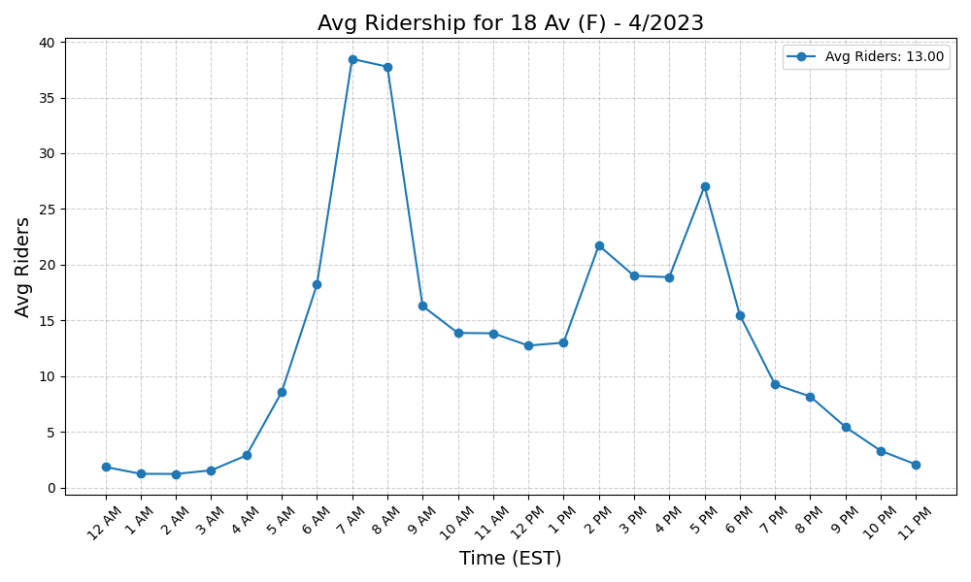
18 Av (F) - 4/2023

Slide 4
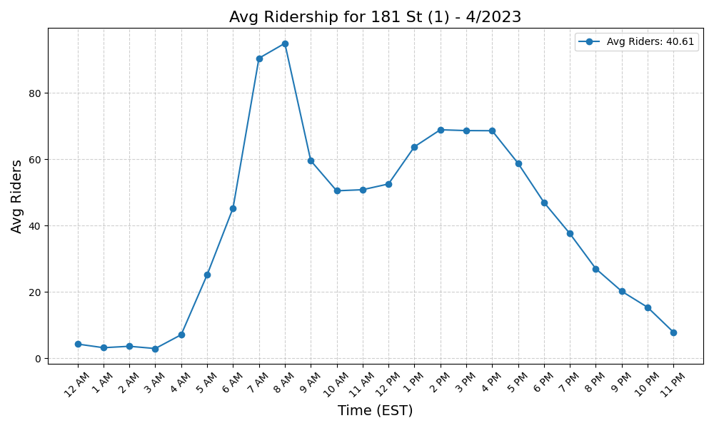
181 St (1) - 4/2023

Slide 5
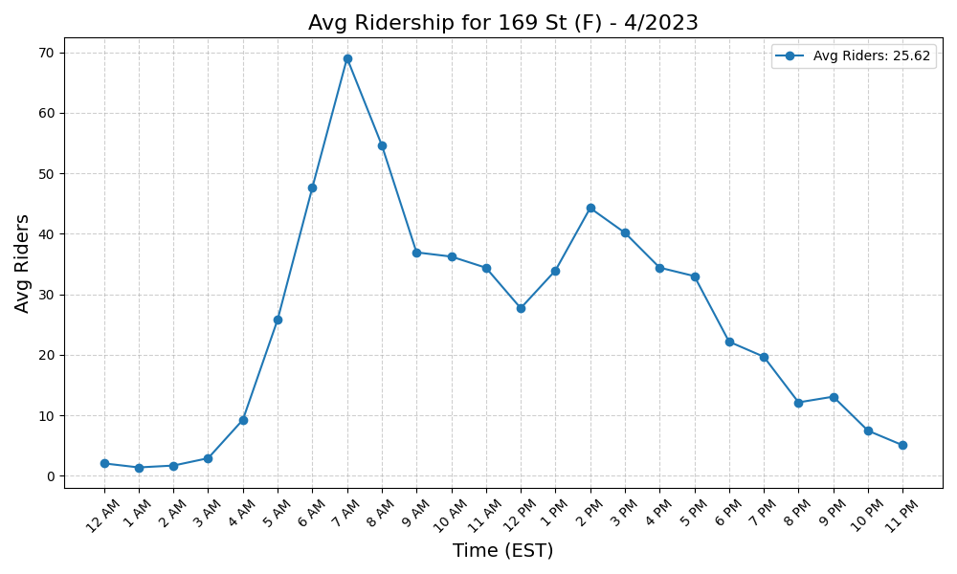
169 St (F) - 4/2023

Slide 6

88 St (A) - 4/2023

Slide 7
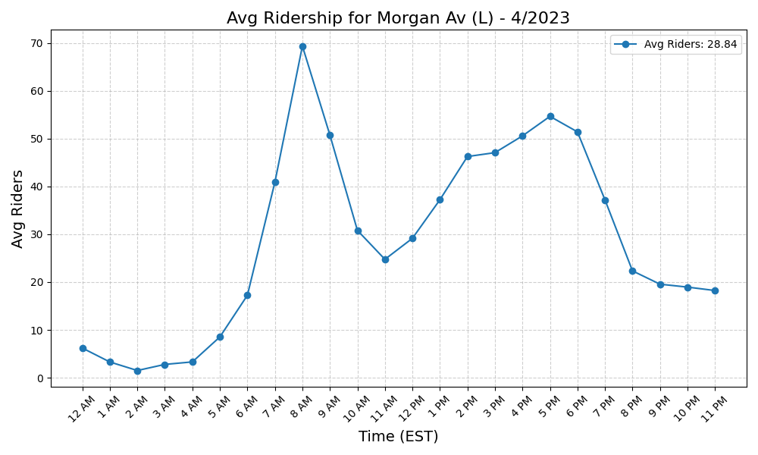
Morgan Av (L) - 4/2023

Slide 8
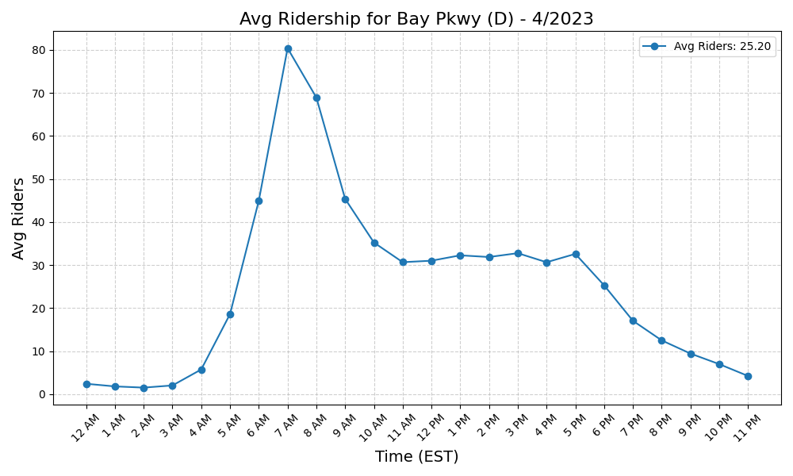
Bay Pkwy (D) - 4/2023

Slide 9
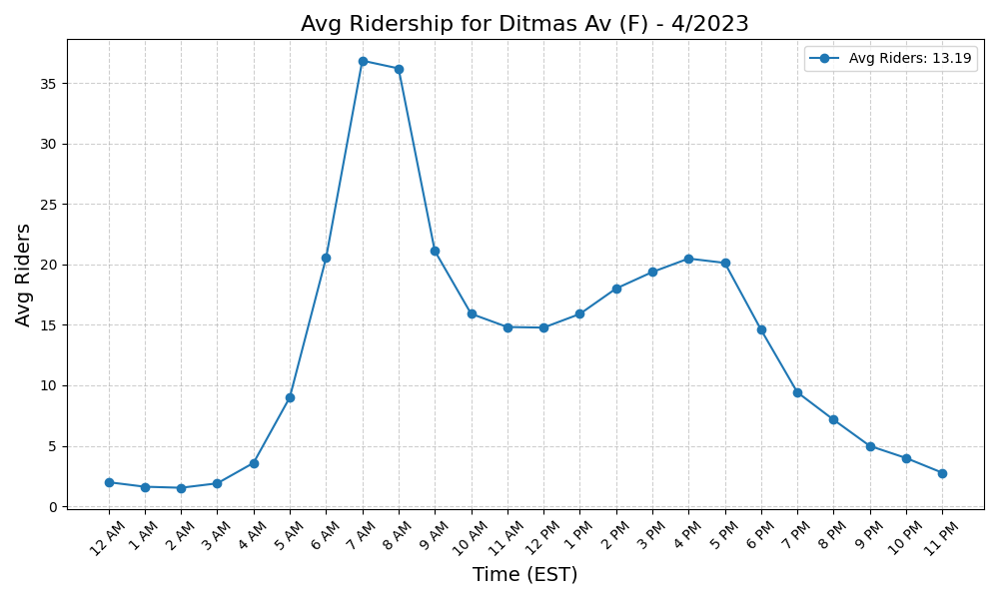
Ditmas Av (F) - 4/2023

Slide 10
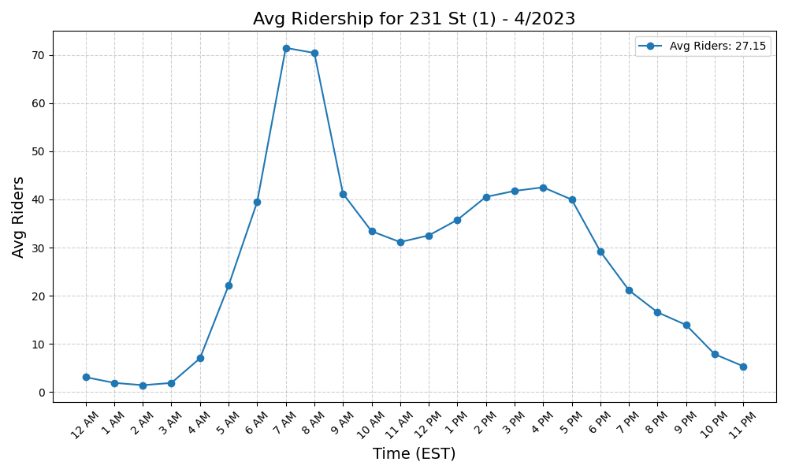
231 St (1) - 4/2023

Slide 11

Avenue X (F) - 4/2023

Slide 12
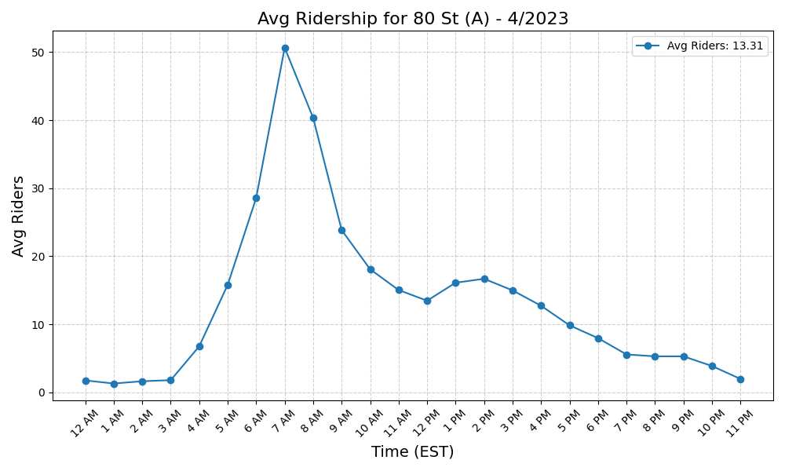
80 St (A) - 4/2023

Slide 13
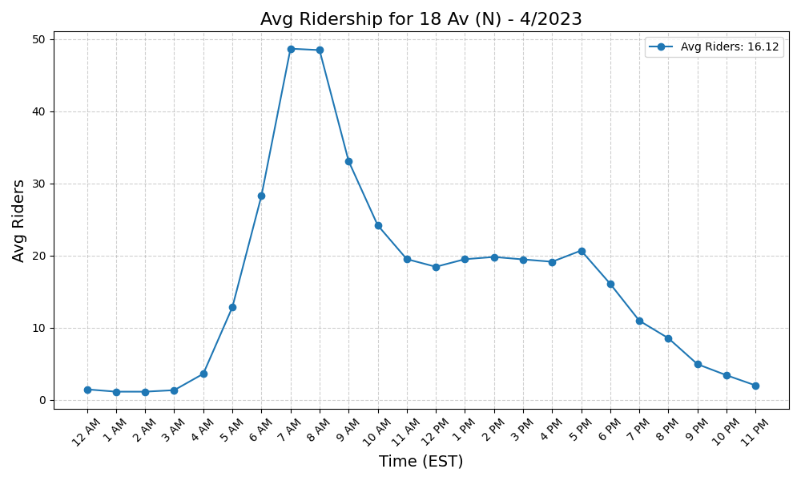
18 Av (N) - 4/2023

Slide 14
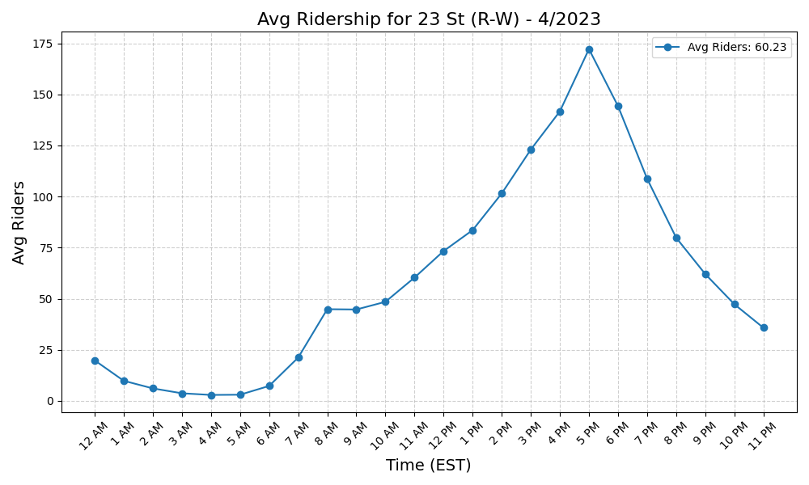
23 St (R-W) - 4/2023

Slide 15
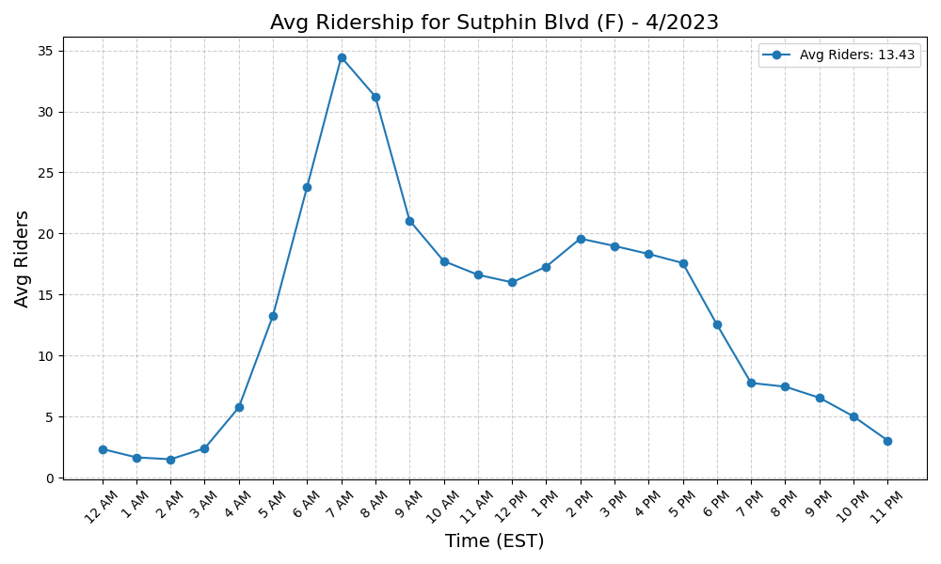
Sutphin Blvd (F) - 4/2023

Slide 16
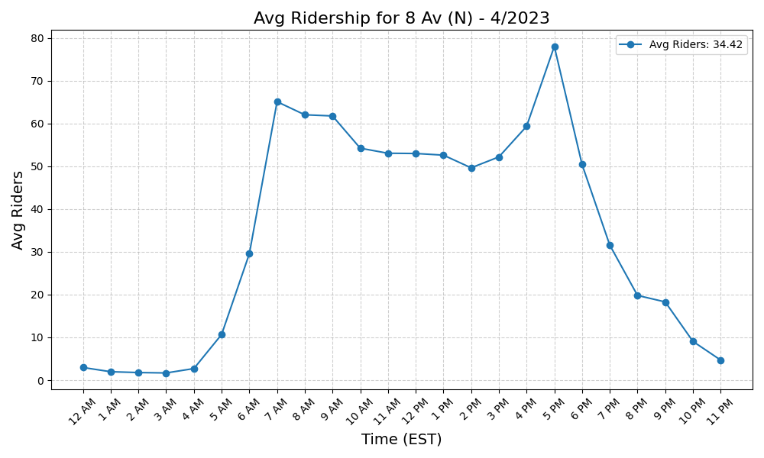
8 Av (N) - 4/2023

Slide 17

Grant Av (A) - 4/2023

Slide 18
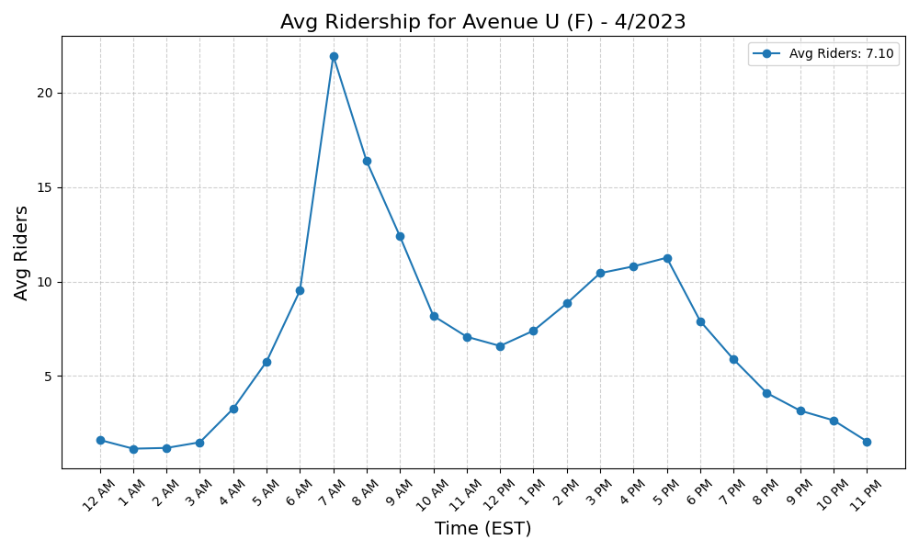
Avenue U (F) - 4/2023

Slide 19
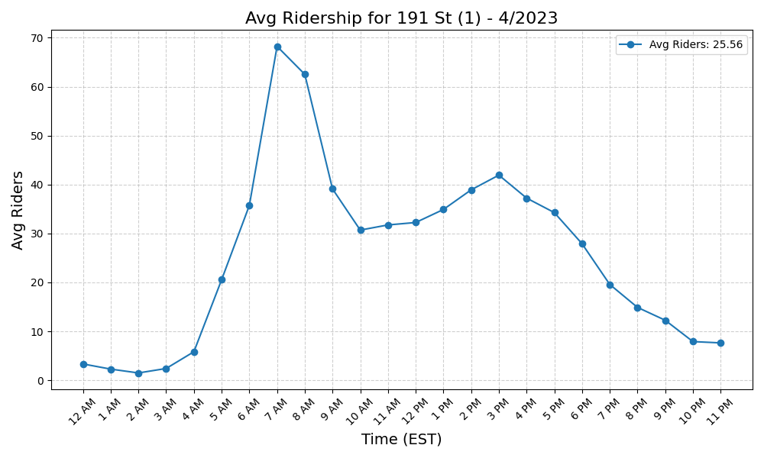
191 St (1) - 4/2023

Slide 20
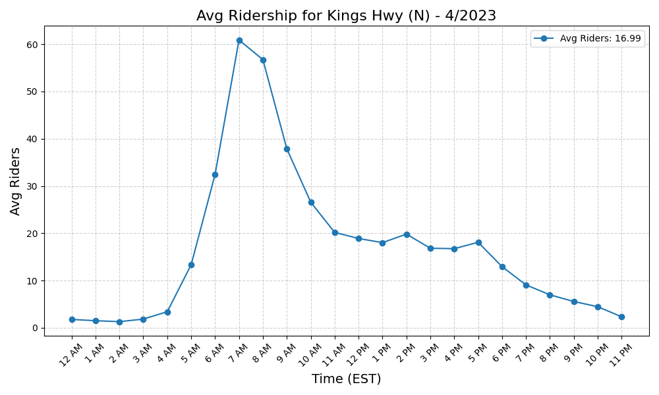
Kings Hwy (N) - 4/2023

Slide 21
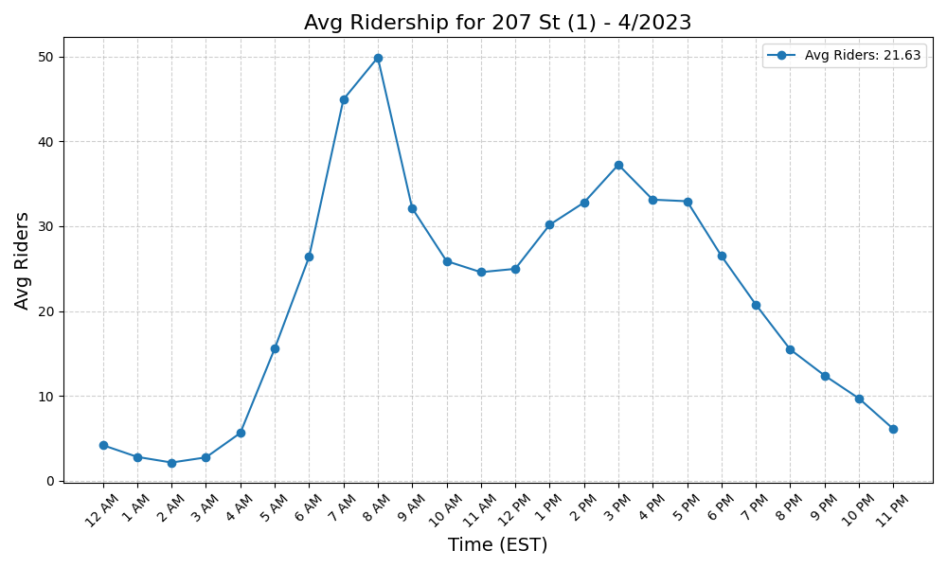
207 St (1) - 4/2023

Slide 22
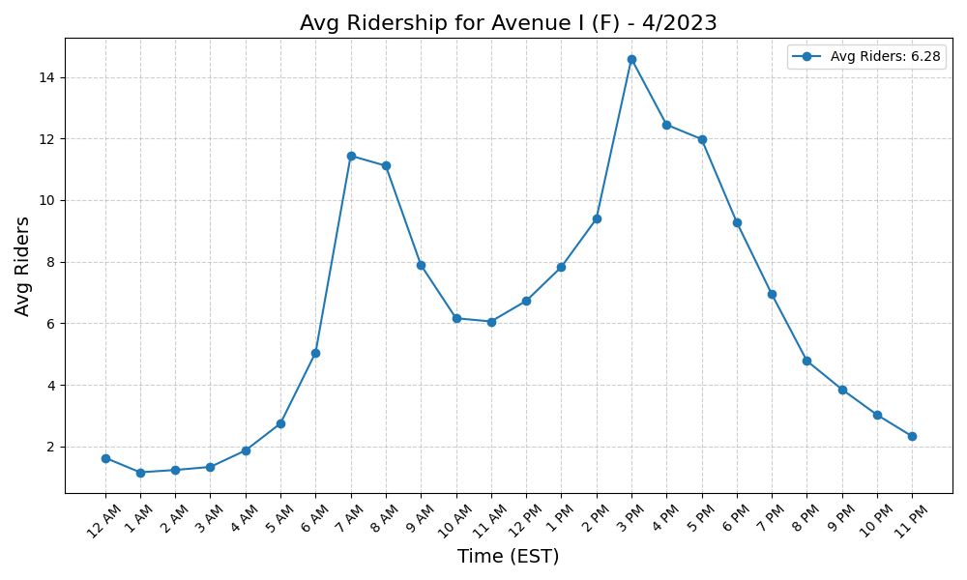
Avenue I (F) - 4/2023

Slide 23
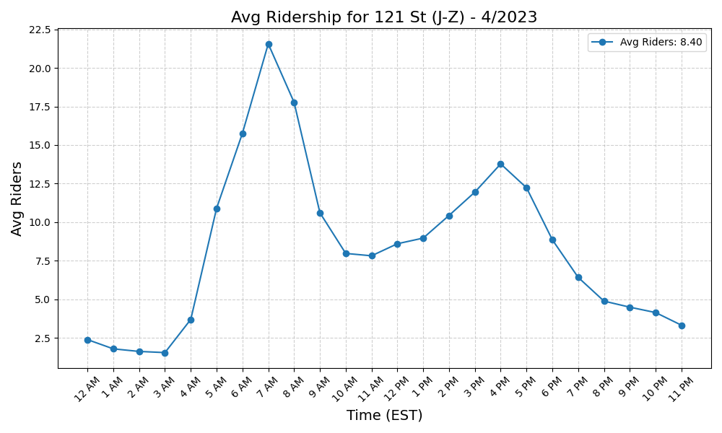
121 St (J-Z) - 4/2023

Slide 24

Avenue P (F) - 4/2023

Slide 25
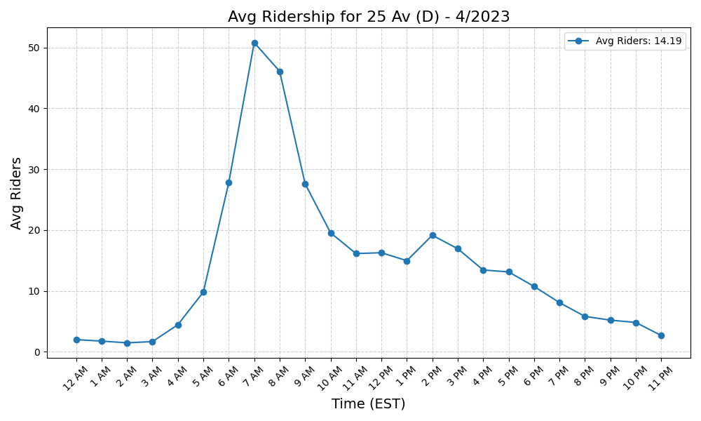
25 Av (D) - 4/2023

Slide 26
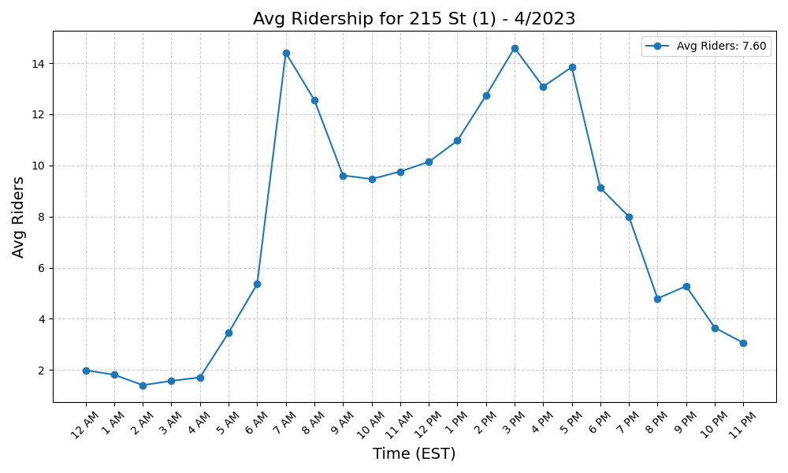
215 St (1) - 4/2023

Slide 27
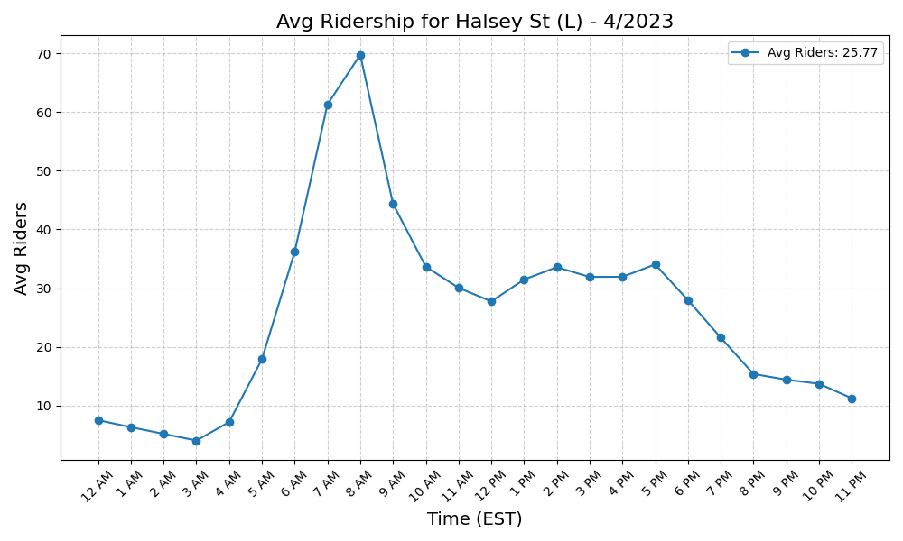
Halsey St (L) - 4/2023

Slide 28
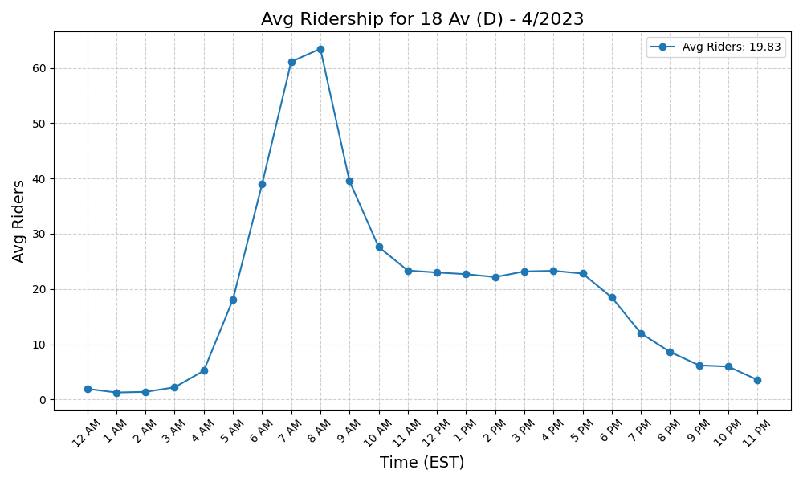
18 Av (D) - 4/2023

Slide 29
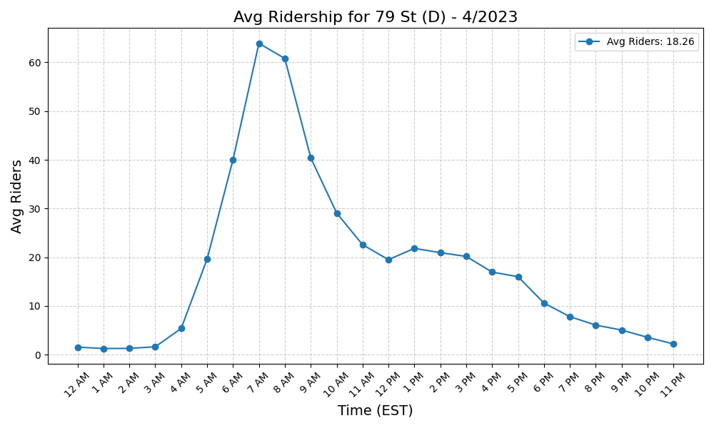
79 St (D) - 4/2023

Slide 30
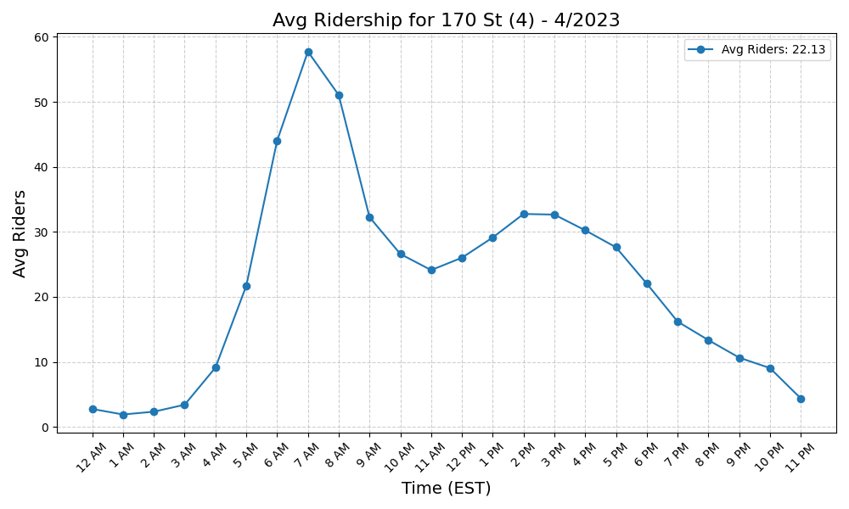
170 St (4) - 4/2023

Slide 31
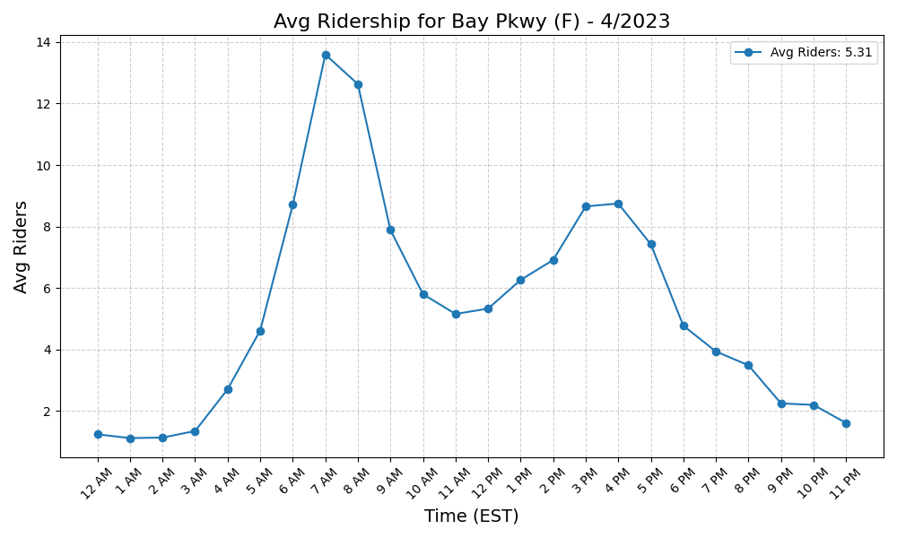
Bay Pkwy (F) - 4/2023

Slide 32
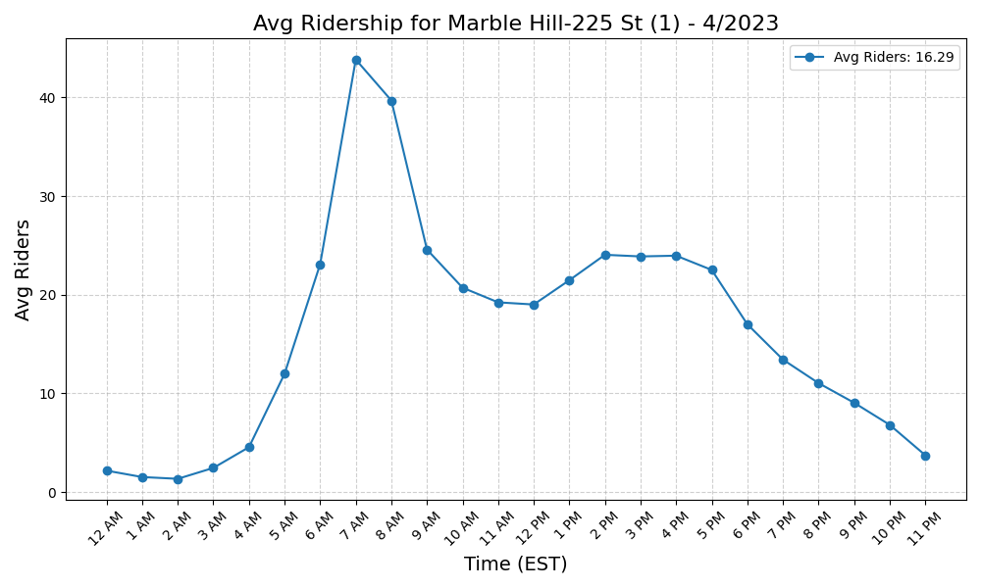
Marble Hill-225 St (1) - 4/2023

Slide 33
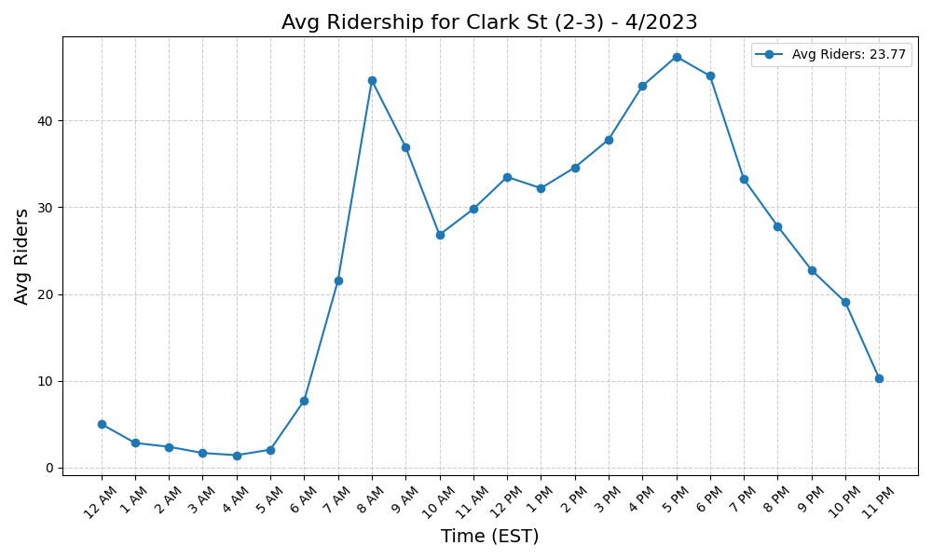
Clark St (2-3) - 4/2023

Slide 34
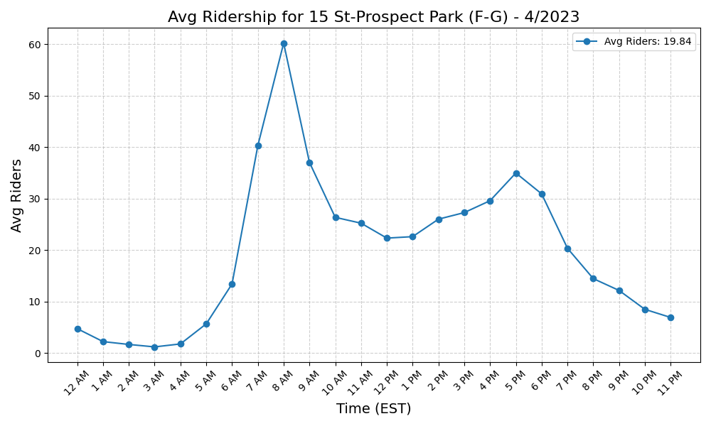
15 St-Prospect Park (F-G) - 4/2023

Slide 35
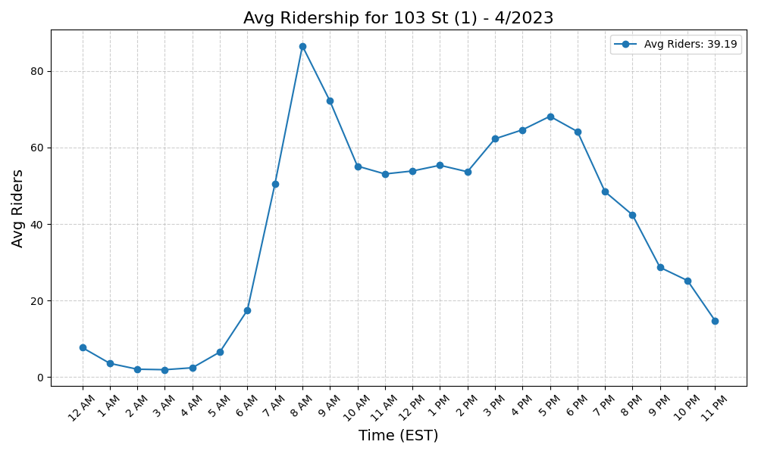
103 St (1) - 4/2023

Slide 36
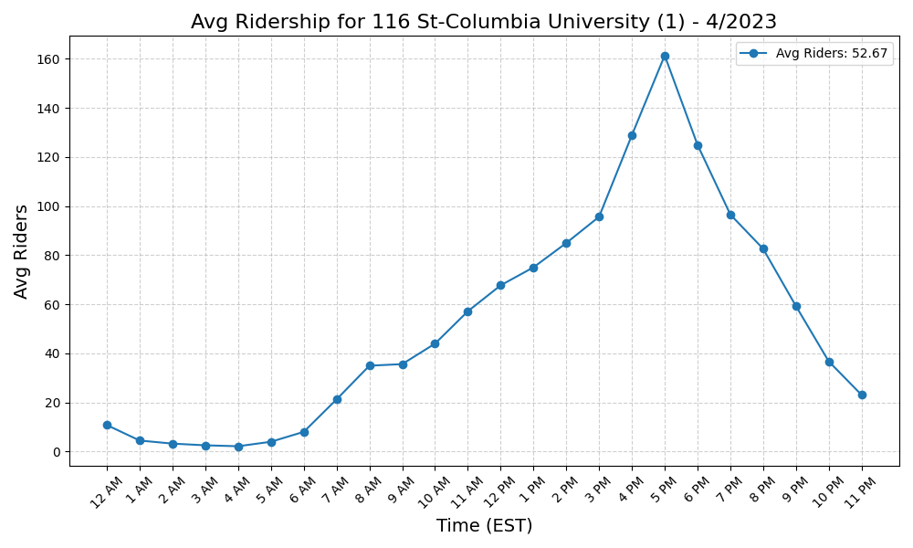
116 St-Columbia University (1) - 4/2023

Slide 37
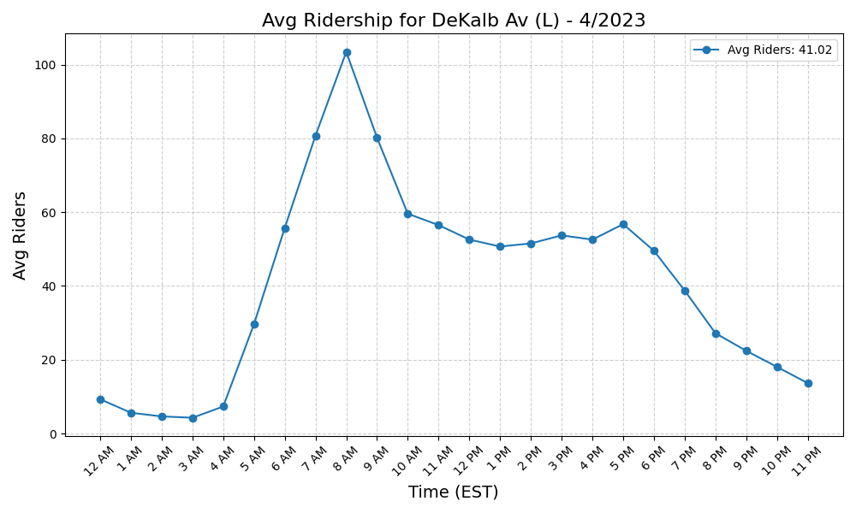
DeKalb Av (L) - 4/2023

Slide 38
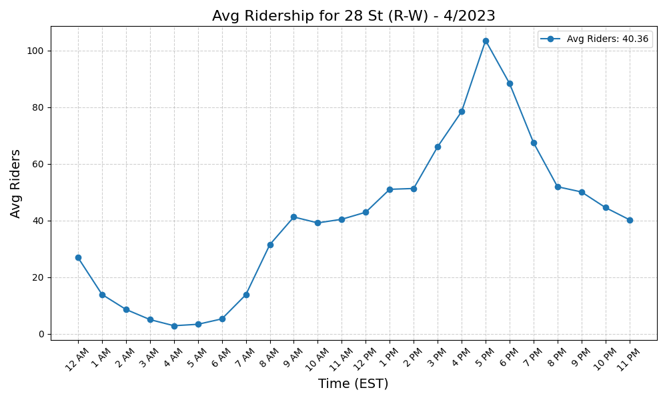
28 St (R-W) - 4/2023

Slide 39
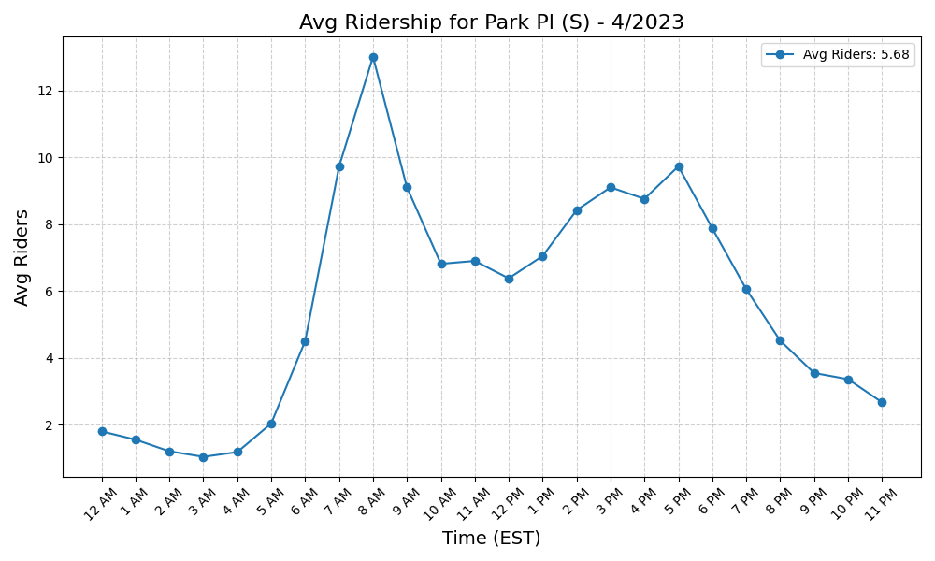
Park Pl (S) - 4/2023

Slide 40
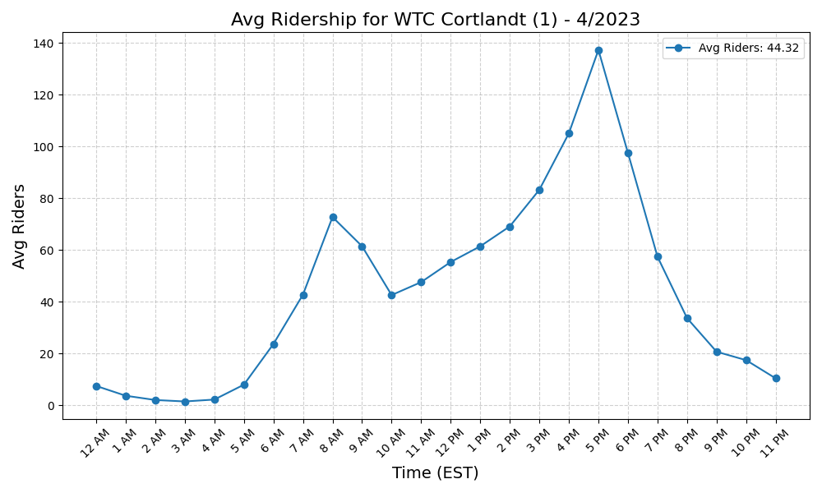
WTC Cortlandt (1) - 4/2023

Slide 41
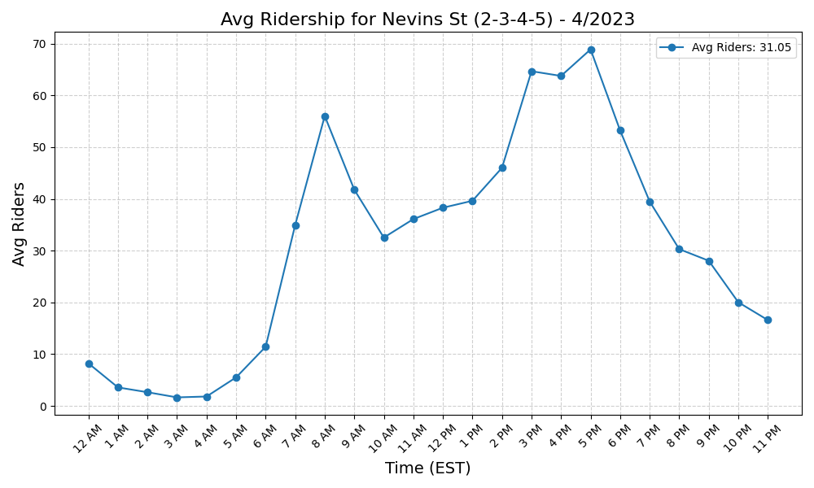
Nevins St (2-3-4-5) - 4/2023

Slide 42
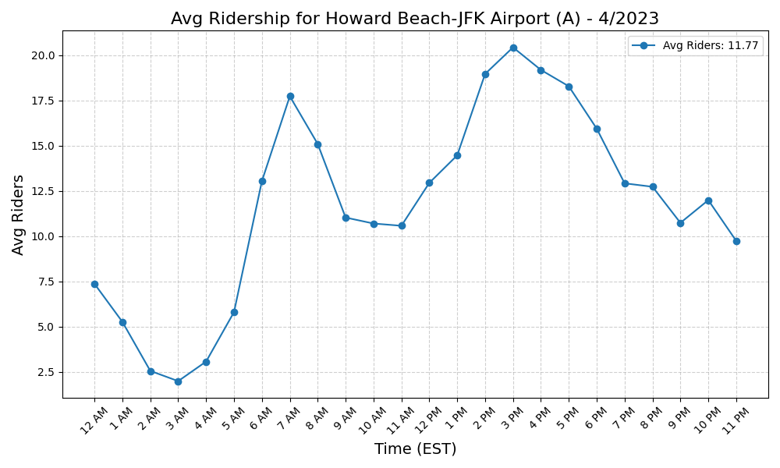
Howard Beach-JFK Airport (A) - 4/2023

Slide 43
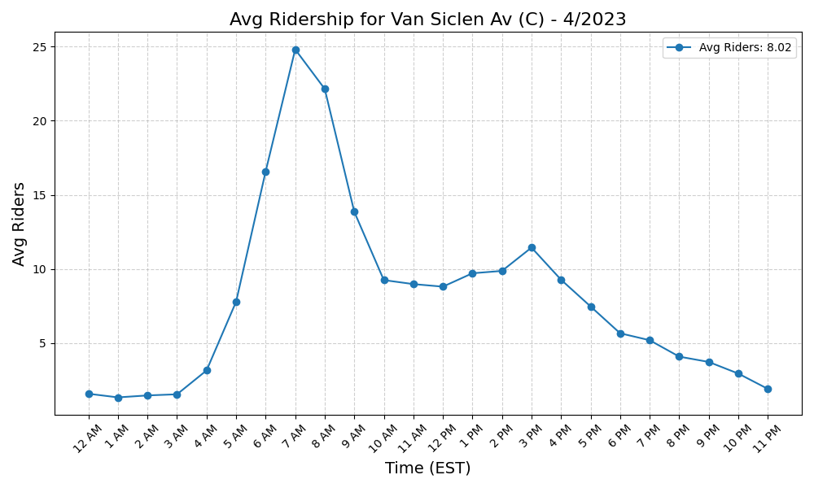
Van Siclen Av (C) - 4/2023

Slide 44
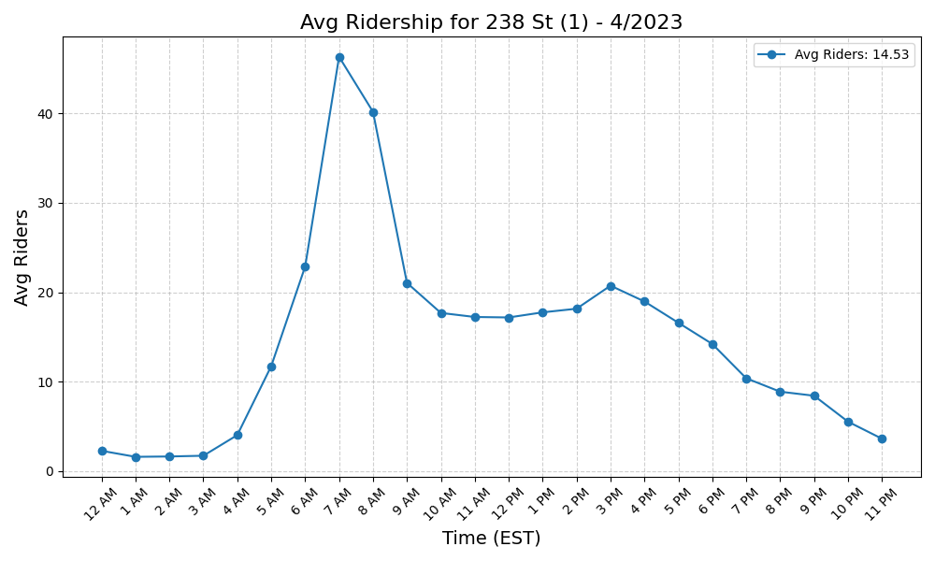
238 St (1) - 4/2023

Slide 45
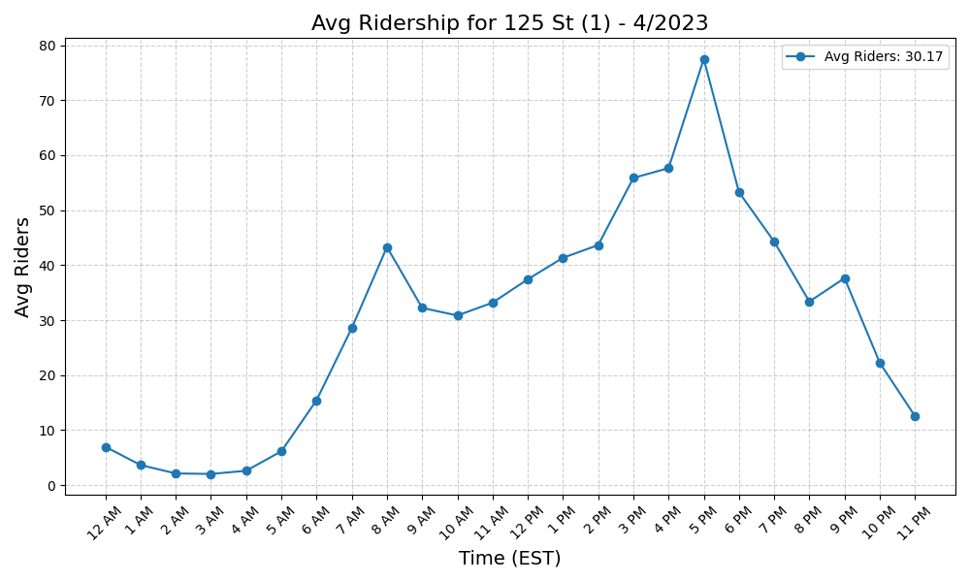
125 St (1) - 4/2023

Slide 46
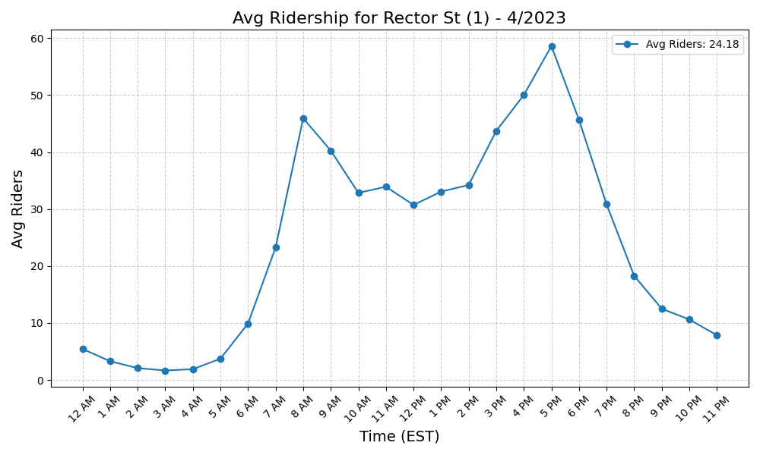
Rector St (1) - 4/2023

Slide 47
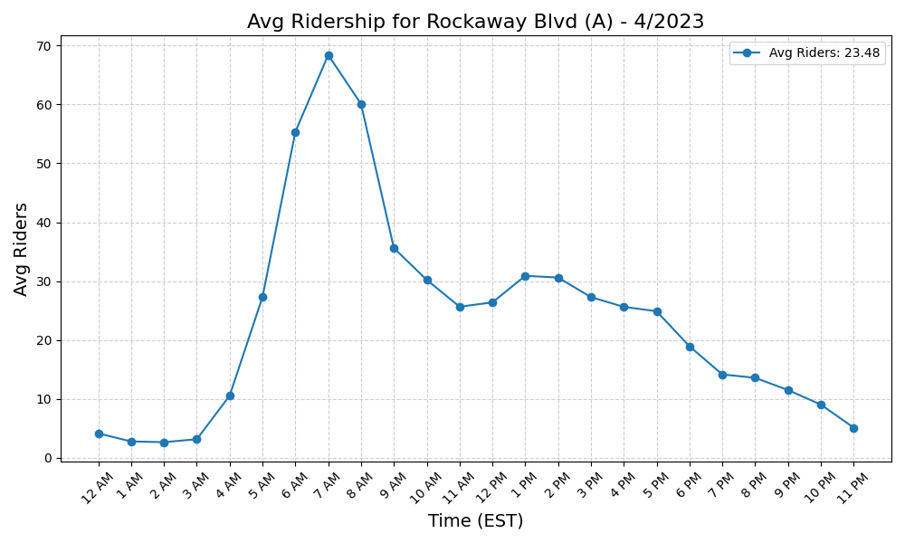
Rockaway Blvd (A) - 4/2023

Slide 48
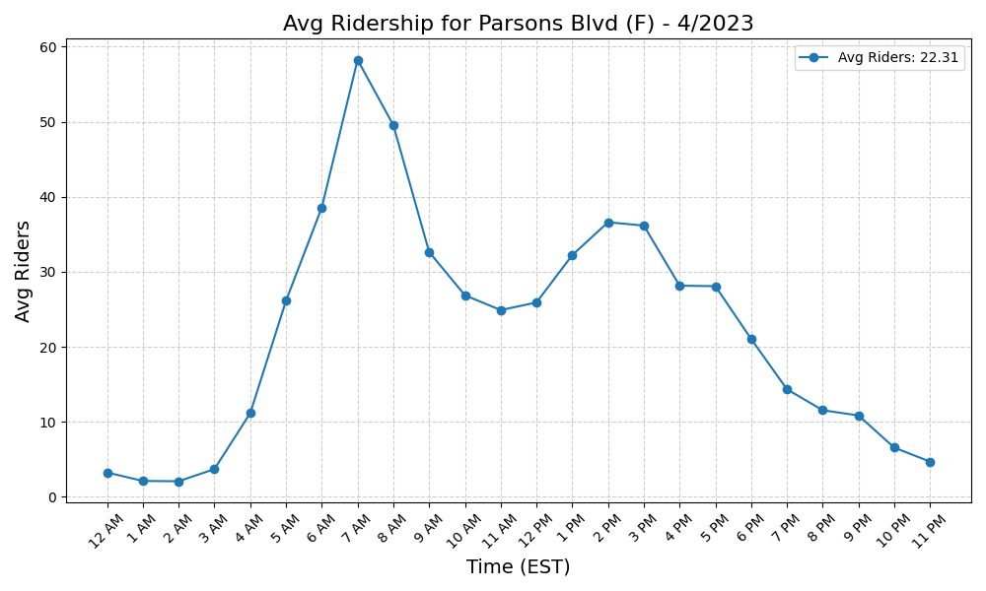
Parsons Blvd (F) - 4/2023

Slide 49
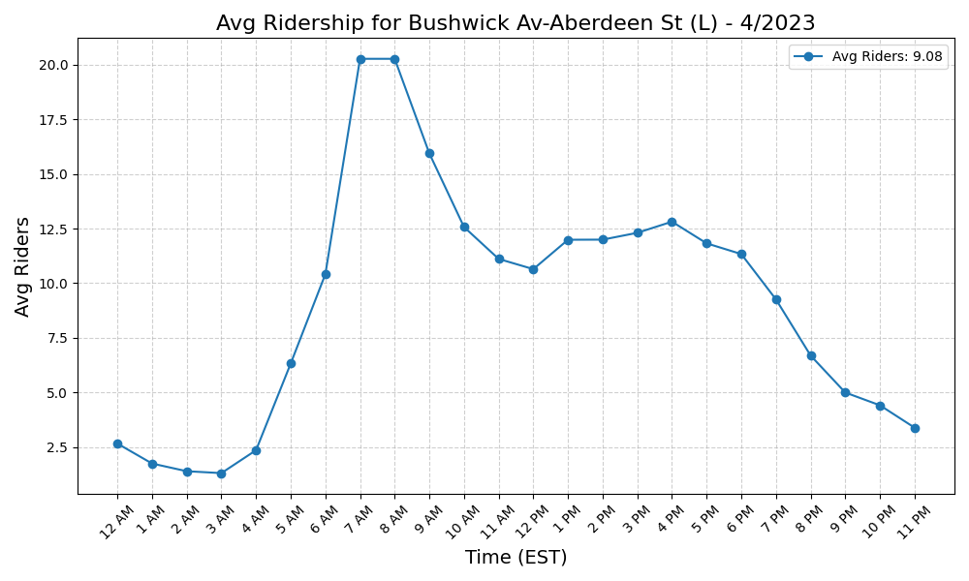
Bushwick Av-Aberdeen St (L) - 4/2023

Slide 50
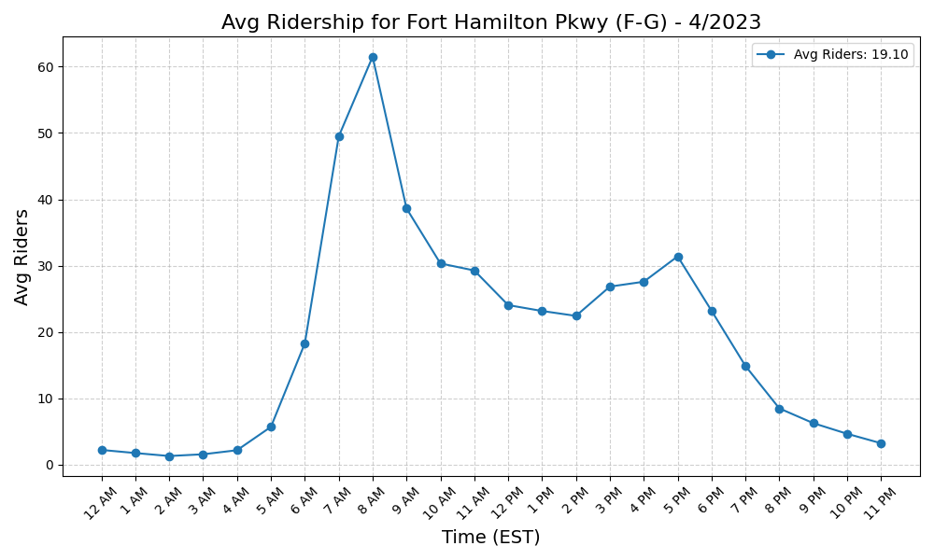
Fort Hamilton Pkwy (F-G) - 4/2023

Slide 51
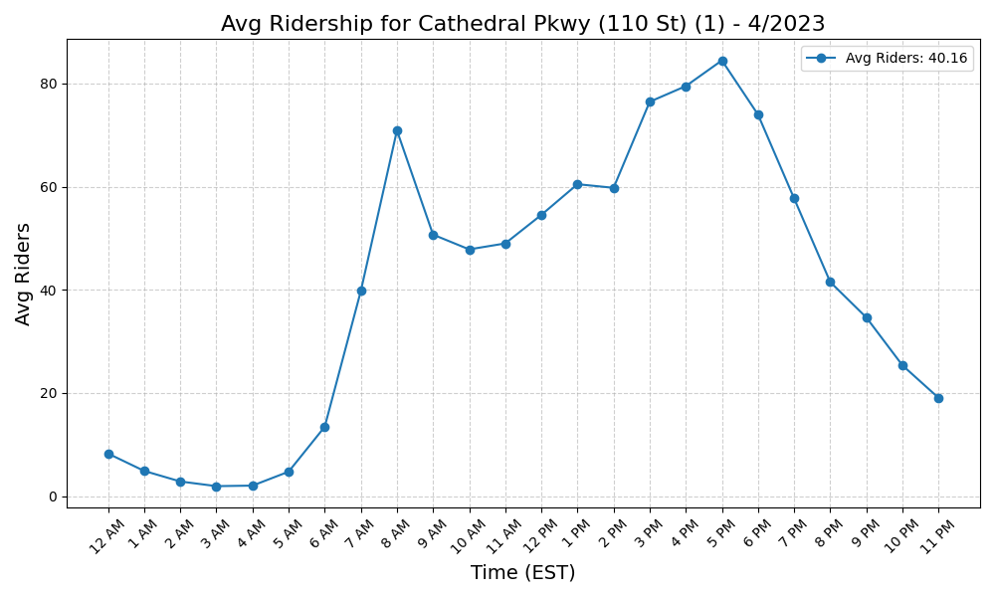
Cathedral Pkwy (110 St) (1) - 4/2023

Slide 52
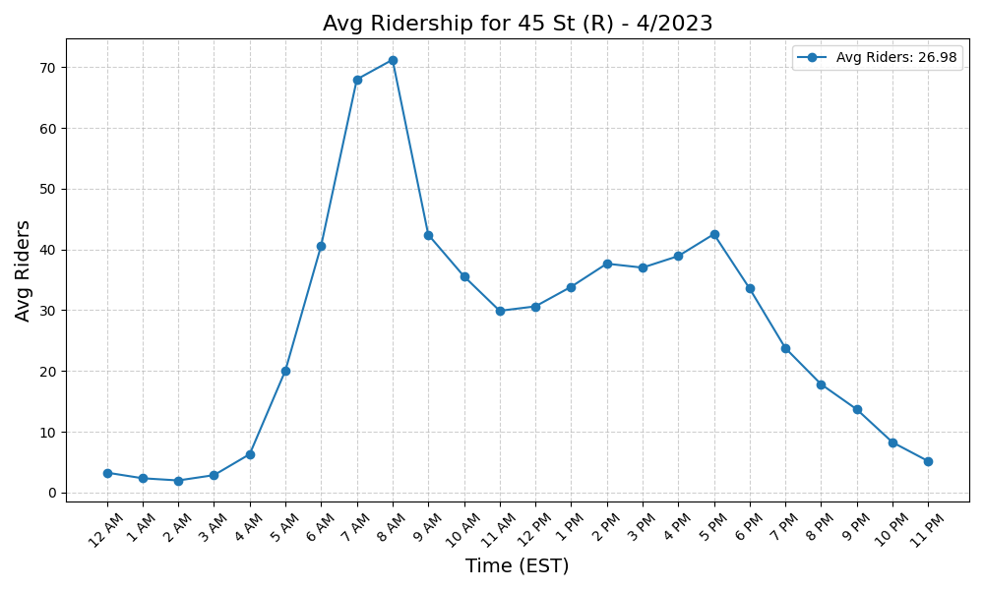
45 St (R) - 4/2023

Slide 53
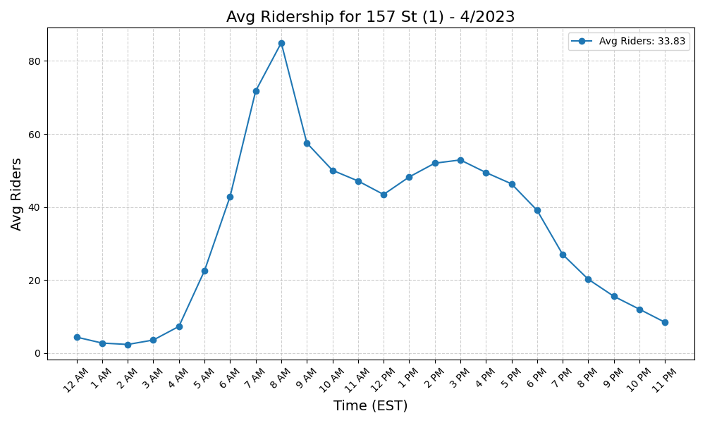
157 St (1) - 4/2023

Slide 54
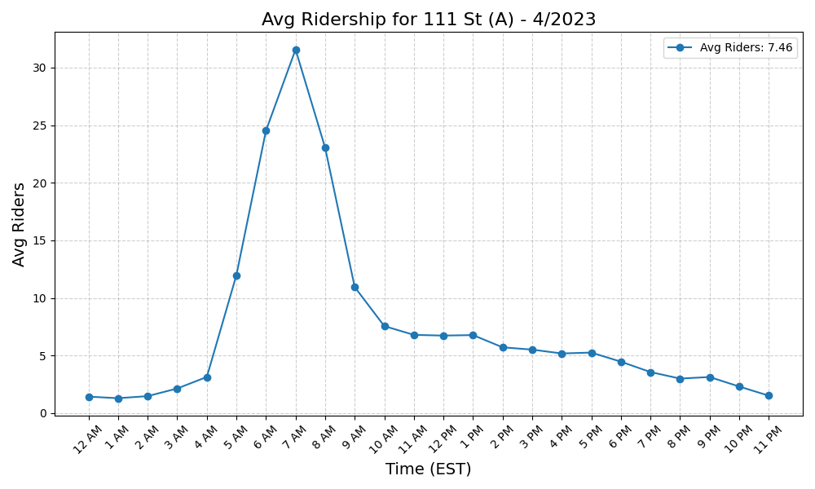
111 St (A) - 4/2023

Slide 55

Avenue U (N) - 4/2023

Slide 56

137 St-City College (1) - 4/2023

Slide 57

Bay Pkwy (N) - 4/2023

Slide 58

Fort Hamilton Pkwy (N) - 4/2023

Slide 59

Dyckman St (A) - 4/2023

Slide 60

20 Av (N) - 4/2023

Slide 61

53 St (R) - 4/2023

Slide 62

Beach 98 St (A-S) - 4/2023

Slide 63

20 Av (D) - 4/2023

Slide 64

East 105 St (L) - 4/2023

Slide 65

104 St (A) - 4/2023

Slide 66

Prospect Av (R) - 4/2023

Slide 67

Sutter Av (L) - 4/2023

Slide 68

Wall St (2-3) - 4/2023

Slide 69

Grand Army Plaza (2-3) - 4/2023

Slide 70

111 St (J) - 4/2023

Slide 71

5 Av-59 St (N-R-W) - 4/2023

Slide 72

City Hall (R-W) - 4/2023

Slide 73

Canarsie-Rockaway Pkwy (L) - 4/2023

Slide 74

Hoyt St (2-3) - 4/2023

Slide 75

Dyckman St (1) - 4/2023

Slide 76

Atlantic Av (L) - 4/2023

Slide 77

Wilson Av (L) - 4/2023

Slide 78

Euclid Av (A-C) - 4/2023

Slide 79

Bergen St (2-3) - 4/2023

Slide 80

Astoria Blvd (N-W) - 4/2023

Slide 81

Neptune Av (F) - 4/2023

Slide 82

Jamaica-179 St (F) - 4/2023

Slide 83

New Lots Av (L) - 4/2023

Slide 84

Liberty Av (C) - 4/2023

Slide 85

Aqueduct Racetrack (A) - 4/2023

Slide 86

Ozone Park-Lefferts Blvd (A) - 4/2023

Slide 87

Aqueduct-N Conduit Av (A) - 4/2023

Slide 88

Rockaway Av (C) - 4/2023

Slide 89

Montrose Av (L) - 4/2023

Slide 90

Jefferson St (L) - 4/2023

Slide 91

Livonia Av (L) - 4/2023

Slide 92

Inwood-207 St (A) - 4/2023

Slide 93

Briarwood (E-F) - 4/2023

Slide 94

Shepherd Av (C) - 4/2023

Slide 95

145 St (1) - 4/2023

Slide 96

86 St (N) - 4/2023

Slide 97

Kings Hwy (F) - 4/2023

Slide 98

Beach 90 St (A-S) - 4/2023

Slide 99

Chambers St (1-2-3) - 4/2023

Slide 100

Bay 50 St (D) - 4/2023

Slide 101

Church Av (F-G) - 4/2023

Slide 102

190 St (A) - 4/2023

Slide 103

Broad Channel (A-S) - 4/2023

Slide 104

Eastern Pkwy-Brooklyn Museum (2 - 4/2023

Slide 105

Beach 105 St (A-S) - 4/2023

Slide 106

Franklin St (1) - 4/2023

Slide 107

Central Av (M) - 4/2023

Slide 108

135 St (C-B) - 4/2023

Slide 109

Mt Eden Av (4) - 4/2023

Slide 110

Crown Hts-Utica Av (3-4) - 4/2023

Slide 111

Seneca Av (M) - 4/2023

Slide 112

125 St (2-3) - 4/2023

Slide 113

65 St (M-R) - 4/2023

Slide 114

Mets-Willets Point (7) - 4/2023

Slide 115

135 St (2-3) - 4/2023

Slide 116

Saratoga Av (3) - 4/2023

Slide 117

President St-Medgar Evers Colle - 4/2023

Slide 118

145 St (3) - 4/2023

Slide 119

3 Av-149 St (2-5) - 4/2023

Slide 120

Kingsbridge Rd (B-D) - 4/2023

Slide 121

182-183 Sts (B-D) - 4/2023

Slide 122

86 St (R) - 4/2023

Slide 123

Fordham Rd (B-D) - 4/2023

Slide 124

63 Dr-Rego Park (M-R) - 4/2023

Slide 125

46 St (M-R) - 4/2023

Slide 126

Graham Av (L) - 4/2023

Slide 127

Junius St (3) - 4/2023

Slide 128

Flatbush Av-Brooklyn College (2 - 4/2023

Slide 129

Marcy Av (M-J-Z) - 4/2023

Slide 130

Pelham Pkwy (5) - 4/2023

Slide 131

183 St (4) - 4/2023

Slide 132

96 St (C-B) - 4/2023

Slide 133

Fresh Pond Rd (M) - 4/2023

Slide 134

181 St (A) - 4/2023

Slide 135

163 St-Amsterdam Av (C) - 4/2023

Slide 136

103 St (C-B) - 4/2023

Slide 137

116 St (2-3) - 4/2023

Slide 138

Woodhaven Blvd (M-R) - 4/2023

Slide 139

Bay Ridge-95 St (R) - 4/2023

Slide 140

Cathedral Pkwy (110 St) (C-B) - 4/2023

Slide 141

Bowery (J-Z) - 4/2023

Slide 142

174-175 Sts (B-D) - 4/2023

Slide 143

Broad St (J-Z) - 4/2023

Slide 144

50 St (C-E) - 4/2023

Slide 145

Sterling St (2-5) - 4/2023

Slide 146

Beach 67 St (A) - 4/2023

Slide 147

Jackson Av (2-5) - 4/2023

Slide 148

Harlem-148 St (3) - 4/2023

Slide 149

175 St (A) - 4/2023

Slide 150

Grand Av-Newtown (M-R) - 4/2023

Slide 151

75 Av (E-F) - 4/2023

Slide 152

116 St (C-B) - 4/2023

Slide 153

167 St (4) - 4/2023

Slide 154

Grand St (L) - 4/2023

Slide 155

125 St (4-5-6) - 4/2023

Slide 156

Sutter Av-Rutland Rd (3) - 4/2023

Slide 157

Kew Gardens-Union Tpke (E-F) - 4/2023

Slide 158

Prospect Av (2-5) - 4/2023

Slide 159

Flushing-Main St (7) - 4/2023

Slide 160

Beach 36 St (A) - 4/2023

Slide 161

Gun Hill Rd (5) - 4/2023

Slide 162

Kingsbridge Rd (4) - 4/2023

Slide 163

Morris Park (5) - 4/2023

Slide 164

Beach 44 St (A) - 4/2023

Slide 165

Steinway St (M-R) - 4/2023

Slide 166

145 St (A-C-B-D) - 4/2023

Slide 167

Beverly Rd (2-5) - 4/2023

Slide 168

New Lots Av (3) - 4/2023

Slide 169

155 St (C) - 4/2023

Slide 170

Knickerbocker Av (M) - 4/2023

Slide 171

Church Av (B-Q) - 4/2023

Slide 172

155 St (B-D) - 4/2023

Slide 173

Middle Village-Metropolitan Av - 4/2023

Slide 174

138 St-Grand Concourse (4-5) - 4/2023

Slide 175

Bedford Av (L) - 4/2023

Slide 176

Bedford Park Blvd (B-D) - 4/2023

Slide 177

170 St (B-D) - 4/2023

Slide 178

Queens Plaza (E-M-R) - 4/2023

Slide 179

Burnside Av (4) - 4/2023

Slide 180

Forest Hills-71 Av (E-F-M-R) - 4/2023

Slide 181

DeKalb Av (B-Q-R) - 4/2023

Slide 182

Norwood-205 St (D) - 4/2023

Slide 183

Van Siclen Av (3) - 4/2023

Slide 184

167 St (B-D) - 4/2023

Slide 185

Woodlawn (4) - 4/2023

Slide 186

3 Av (L) - 4/2023

Slide 187

Central Park North (110 St) (2- - 4/2023

Slide 188

Rockaway Park-Beach 116 St (A-S - 4/2023

Slide 189

Rockaway Av (3) - 4/2023

Slide 190

Tremont Av (B-D) - 4/2023

Slide 191

Mosholu Pkwy (4) - 4/2023

Slide 192

176 St (4) - 4/2023

Slide 193

Bay Ridge Av (R) - 4/2023

Slide 194

Kingston Av (3) - 4/2023

Slide 195

59 St (N-R) - 4/2023

Slide 196

49 St (N-R-W) - 4/2023

Slide 197

Beach 25 St (A) - 4/2023

Slide 198

Hewes St (M-J) - 4/2023

Slide 199

Rector St (R-W) - 4/2023

Slide 200

Astoria-Ditmars Blvd (N-W) - 4/2023

Slide 201

Pennsylvania Av (3) - 4/2023

Slide 202

125 St (A-C-B-D) - 4/2023

Slide 203

Fordham Rd (4) - 4/2023

Slide 204

Forest Av (M) - 4/2023

Slide 205

Baychester Av (5) - 4/2023

Slide 206

Intervale Av (2-5) - 4/2023

Slide 207

81 St-Museum of Natural History - 4/2023

Slide 208

116 St (6) - 4/2023

Slide 209

Elmhurst Av (M-R) - 4/2023

Slide 210

Far Rockaway-Mott Av (A) - 4/2023

Slide 211

Winthrop St (2-5) - 4/2023

Slide 212

Bedford Park Blvd-Lehman Colleg - 4/2023

Slide 213

1 Av (L) - 4/2023

Slide 214

Church Av (2-5) - 4/2023

Slide 215

72 St (C-B) - 4/2023

Slide 216

Pelham Bay Park (6) - 4/2023

Slide 217

67 Av (M-R) - 4/2023

Slide 218

86 St (C-B) - 4/2023

Slide 219

36 St (M-R) - 4/2023

Slide 220

Eastchester-Dyre Av (5) - 4/2023

Slide 221

Beach 60 St (A) - 4/2023

Slide 222

8 St-NYU (R-W) - 4/2023

Slide 223

Nostrand Av (3) - 4/2023

Slide 224

Newkirk Av-Little Haiti (2-5) - 4/2023

Slide 225

Northern Blvd (M-R) - 4/2023

Slide 226

3 Av-138 St (6) - 4/2023

Slide 227

Buhre Av (6) - 4/2023

Slide 228

21 St-Queensbridge (F) - 4/2023

Slide 229

Ocean Pkwy (Q) - 4/2023

Slide 230

Brook Av (6) - 4/2023

Slide 231

High St (A-C) - 4/2023

Slide 232

Elder Av (6) - 4/2023

Slide 233

Spring St (6) - 4/2023

Slide 234

25 St (R) - 4/2023

Slide 235

96 St (6) - 4/2023

Slide 236

Hunters Point Av (7) - 4/2023

Slide 237

E 143 St-St Mary-s St (6) - 4/2023

Slide 238

Coney Island-Stillwell Av (D-F- - 4/2023

Slide 239

Grand St (B-D) - 4/2023

Slide 240

E 149 St (6) - 4/2023

Slide 241

77 St (6) - 4/2023

Slide 242

Christopher St-Sheridan Sq (1) - 4/2023

Slide 243

Longwood Av (6) - 4/2023

Slide 244

Whitlock Av (6) - 4/2023

Slide 245

Ralph Av (C) - 4/2023

Slide 246

Broadway Junction (A-C-J-L-Z) - 4/2023

Slide 247

Myrtle-Wyckoff Avs (L-M) - 4/2023

Slide 248

Smith-9 Sts (F-G) - 4/2023

Slide 249

39 Av-Dutch Kills (N-W) - 4/2023

Slide 250

Parkchester (6) - 4/2023

Slide 251

34 St-Penn Station (1-2-3) - 4/2023

Slide 252

103 St-Corona Plaza (7) - 4/2023

Slide 253

52 St (7) - 4/2023

Slide 254

57 St (F) - 4/2023

Slide 255

71 St (D) - 4/2023

Slide 256

34 St-Penn Station (A-C-E) - 4/2023

Slide 257

33 St-Rawson St (7) - 4/2023

Slide 258

Broadway (N-W) - 4/2023

Slide 259

28 St (6) - 4/2023

Slide 260

68 St-Hunter College (6) - 4/2023

Slide 261

Bowling Green (4-5) - 4/2023

Slide 262

Lorimer St (L)-Metropolitan Av - 4/2023

Slide 263

Castle Hill Av (6) - 4/2023

Slide 264

7 Av (F-G) - 4/2023

Slide 265

28 St (1) - 4/2023

Slide 266

79 St (1) - 4/2023

Slide 267

Wall St (4-5) - 4/2023

Slide 268

46 St-Bliss St (7) - 4/2023

Slide 269

Canal St (J-N-Q-R-W-Z-6) - 4/2023

Slide 270

40 St-Lowery St (7) - 4/2023

Slide 271

Canal St (A-C-E) - 4/2023

Slide 272

Houston St (1) - 4/2023

Slide 273

77 St (R) - 4/2023

Slide 274

Hunts Point Av (6) - 4/2023

Slide 275

33 St (6) - 4/2023

Slide 276

York St (F) - 4/2023

Slide 277

7 Av (B-Q) - 4/2023

Slide 278

86 St (1) - 4/2023

Slide 279

St Lawrence Av (6) - 4/2023

Slide 280

72 St (1-2-3) - 4/2023

Slide 281

86 St (4-5-6) - 4/2023

Slide 282

2 Av (F) - 4/2023

Slide 283

23 St (F-M) - 4/2023

Slide 284

Lafayette Av (C) - 4/2023

Slide 285

Lexington Av-63 St (F-Q) - 4/2023

Slide 286

Jay St-MetroTech (A-C-F-R) - 4/2023

Slide 287

47-50 Sts-Rockefeller Ctr (B-D- - 4/2023

Slide 288

Prince St (R-W) - 4/2023

Slide 289

23 St (6) - 4/2023

Slide 290

111 St (7) - 4/2023

Slide 291

18 St (1) - 4/2023

Slide 292

Cypress Av (6) - 4/2023

Slide 293

Astor Pl (6) - 4/2023

Slide 294

Franklin Av (C-S) - 4/2023

Slide 295

Chambers St (A-C)-WTC (E)-Park - 4/2023

Slide 296

W 8 St-NY Aquarium (F-Q) - 4/2023

Slide 297

Lorimer St (M-J) - 4/2023

Slide 298

Bergen St (F-G) - 4/2023

Slide 299

East Broadway (F) - 4/2023

Slide 300

Utica Av (A-C) - 4/2023

Slide 301

23 St (1) - 4/2023

Slide 302

Delancey St (F)-Essex St (J-M-Z - 4/2023

Slide 303

66 St-Lincoln Center (1) - 4/2023

Slide 304

Fulton St (A-C-J-Z-2-3-4-5) - 4/2023

Slide 305

9 Av (D) - 4/2023

Slide 306

Middletown Rd (6) - 4/2023

Slide 307

Brooklyn Bridge-City Hall (4-5- - 4/2023

Slide 308

RI Tramway (Roosevelt) - 4/2023

Slide 309

Junction Blvd (7) - 4/2023

Slide 310

Fort Hamilton Pkwy (D) - 4/2023

Slide 311

103 St (6) - 4/2023

Slide 312

Kingston-Throop Avs (C) - 4/2023

Slide 313

69 St (7) - 4/2023

Slide 314

Nostrand Av (A-C) - 4/2023

Slide 315

110 St (6) - 4/2023

Slide 316

61 St-Woodside (7) - 4/2023

Slide 317

Franklin Av (2-3-4-5)-Botanic G - 4/2023

Slide 318

Wakefield-241 St (2) - 4/2023

Slide 319

82 St-Jackson Hts (7) - 4/2023

Slide 320

Queensboro Plaza (7-N-W) - 4/2023

Slide 321

36 St (D-N-R) - 4/2023

Slide 322

50 St (1) - 4/2023

Slide 323

Morrison Av-Soundview (6) - 4/2023

Slide 324

23 St (C-E) - 4/2023

Slide 325

Court St (R)-Borough Hall (2-3- - 4/2023

Slide 326

Canal St (1) - 4/2023

Slide 327

South Ferry (1)-Whitehall St (R - 4/2023

Slide 328

Cortelyou Rd (Q) - 4/2023

Slide 329

RI Tramway (Manhattan) - 4/2023

Slide 330

Zerega Av (6) - 4/2023

Slide 331

Hoyt-Schermerhorn Sts (A-C-G) - 4/2023

Slide 332

96 St (1-2-3) - 4/2023

Slide 333

Spring St (C-E) - 4/2023

Slide 334

W 4 St-Wash Sq (A-C-E-B-D-F-M) - 4/2023

Slide 335

Carroll St (F-G) - 4/2023

Slide 336

Clinton-Washington Avs (C) - 4/2023

Slide 337

Westchester Sq-E Tremont Av (6) - 4/2023

Slide 338

90 St-Elmhurst Av (7) - 4/2023

Slide 339

Roosevelt Island (F) - 4/2023

Slide 340

Vernon Blvd-Jackson Av (7) - 4/2023

Slide 341

Beverley Rd (Q) - 4/2023

Slide 342

Halsey St (J) - 4/2023

Slide 343

72 St (Q) - 4/2023

Slide 344

233 St (2-5) - 4/2023

Slide 345

Simpson St (2-5) - 4/2023

Slide 346

86 St (Q) - 4/2023

Slide 347

E 180 St (2-5) - 4/2023

Slide 348

Gates Av (J-Z) - 4/2023

Slide 349

Avenue M (Q) - 4/2023

Slide 350

Lexington Av (N-R-W)-59 St (4-5 - 4/2023

Slide 351

225 St (2-5) - 4/2023

Slide 352

Cleveland St (J) - 4/2023

Slide 353

161 St-Yankee Stadium (B-D-4) - 4/2023

Slide 354

Times Sq-42 St (N-Q-R-W-S-1-2-3 - 4/2023

Slide 355

168 St (A-C-1) - 4/2023

Slide 356

14 St (F-M-1-2-3)-6 Av (L) - 4/2023

Slide 357

34 St-Hudson Yards (7) - 4/2023

Slide 358

Union St (R) - 4/2023

Slide 359

Greenpoint Av (G) - 4/2023

Slide 360

21 St (G) - 4/2023

Slide 361

74-Broadway (7)-Jackson Hts-Roo - 4/2023

Slide 362

Myrtle Av (M-J-Z) - 4/2023

Slide 363

36 Av (N-W) - 4/2023

Slide 364

Sheepshead Bay (B-Q) - 4/2023

Slide 365

75 St-Elderts Ln (J-Z) - 4/2023

Slide 366

Allerton Av (2-5) - 4/2023

Slide 367

Grand Central-42 St (S-4-5-6-7) - 4/2023

Slide 368

Norwood Av (J-Z) - 4/2023

Slide 369

Jamaica-Van Wyck (E) - 4/2023

Slide 370

34 St-Herald Sq (B-D-F-M-N-Q-R- - 4/2023

Slide 371

Court Sq (E-G-M-7) - 4/2023

Slide 372

Burke Av (2-5) - 4/2023

Slide 373

Van Cortlandt Park-242 St (1) - 4/2023

Slide 374

Alabama Av (J) - 4/2023

Slide 375

Gun Hill Rd (2-5) - 4/2023

Slide 376

Brighton Beach (B-Q) - 4/2023

Slide 377

Broadway (G) - 4/2023

Slide 378

174 St (2-5) - 4/2023

Slide 379

96 St (Q) - 4/2023

Slide 380

Parkside Av (Q) - 4/2023

Slide 381

55 St (D) - 4/2023

Slide 382

4 Av (F-G)-9 St (R) - 4/2023

Slide 383

219 St (2-5) - 4/2023

Slide 384

Van Siclen Av (J-Z) - 4/2023

Slide 385

Atlantic Av-Barclays Ctr (B-D-N - 4/2023

Slide 386

Broadway-Lafayette St (B-D-F-M) - 4/2023

Slide 387

5 Av-53 St (E-M) - 4/2023

Slide 388

Woodhaven Blvd (J-Z) - 4/2023

Slide 389

Freeman St (2-5) - 4/2023

Slide 390

Nereid Av (2-5) - 4/2023

Slide 391

Avenue H (Q) - 4/2023

Slide 392

Newkirk Plaza (B-Q) - 4/2023

Slide 393

Bryant Pk (B-D-F-M)-5 Av (7) - 4/2023

Slide 394

Lexington Av-53 St (E-M)-51 St - 4/2023

Slide 395

Classon Av (G) - 4/2023

Slide 396

Myrtle-Willoughby Avs (G) - 4/2023

Slide 397

149 St-Grand Concourse (2-4-5) - 4/2023

Slide 398

Cypress Hills (J) - 4/2023

Slide 399

Sutphin Blvd-Archer Av-JFK Airp - 4/2023

Slide 400

Clinton-Washington Avs (G) - 4/2023

Slide 401

Nassau Av (G) - 4/2023

Slide 402

Crescent St (J-Z) - 4/2023

Slide 403

St George (SIR) - 4/2023

Slide 404

14 St-Union Sq (L-N-Q-R-W-4-5-6 - 4/2023

Slide 405

Chauncey St (J-Z) - 4/2023

Slide 406

Flushing Av (M-J) - 4/2023

Slide 407

Avenue U (Q) - 4/2023

Slide 408

7 Av (E-B-D) - 4/2023

Slide 409

Neck Rd (Q) - 4/2023

Slide 410

Bedford-Nostrand Avs (G) - 4/2023

Slide 411

Flushing Av (G) - 4/2023

Slide 412

Kings Hwy (B-Q) - 4/2023

Slide 413

Prospect Park (B-Q-S) - 4/2023

Slide 414

85 St-Forest Pkwy (J) - 4/2023

Slide 415

Kosciuszko St (J) - 4/2023

Slide 416

14 St (A-C-E)-8 Av (L) - 4/2023

Slide 417

Bronx Park East (2-5) - 4/2023

Slide 418

Jamaica Center-Parsons-Archer ( - 4/2023

Slide 419

104 St (J-Z) - 4/2023

Slide 420

59 St-Columbus Circle (A-B-C-D- - 4/2023

Slide 421

West Farms Sq-E Tremont Av (2-5 - 4/2023

Slide 422

Pelham Pkwy (2-5) - 4/2023

Slide 423

Fulton St (G) - 4/2023

Slide 424

Avenue J (Q) - 4/2023

Slide 425

57 St-7 Av (N-Q-R-W) - 4/2023

Slide 426

New Utrecht Av (N)-62 St (D) - 4/2023

Slide 427

50 St (D) - 4/2023

Slide 428

Tompkinsville (SIR) - 4/2023

